Slide 1

FinTech-A-Thon ‘25
Problem Statement: IDFC First Bank
Core Challenge: Build an AI-driven tool to silence scam calls for good.
Team Name: Friskel Freaks
Ajeethan A
Karthikraj M R
Sharan Prashanth S
Kishore P
Vishwa Prasanth G

Slide 2


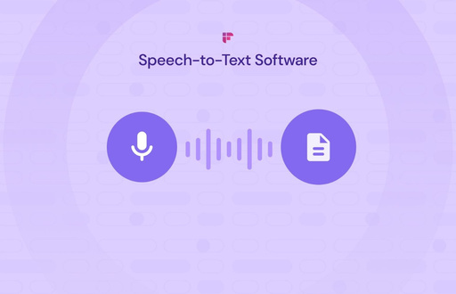
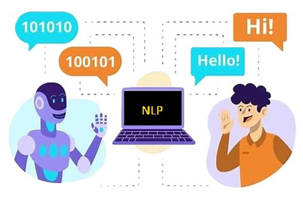
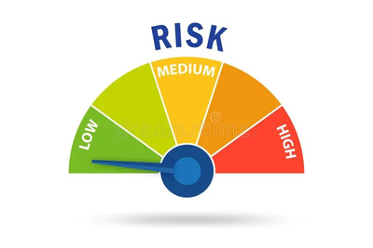
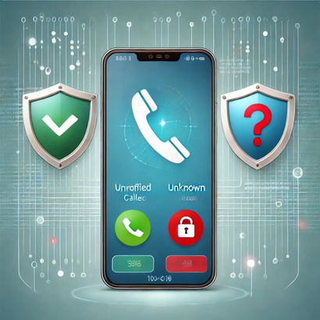
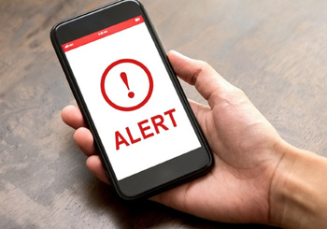
IDEA / SOLUTION
Speech-to-Text Conversion: Converts live call audio into text.
NLP & Pattern Detection: Analyzes keywords, tone, and call context.
Risk Scoring: Determines scam probability using AI.
Caller Verification: Identifies legitimate vs. unknown callers.
User Alerting: Notifies users via SMS, mobile app, or call blocking.

Slide 3


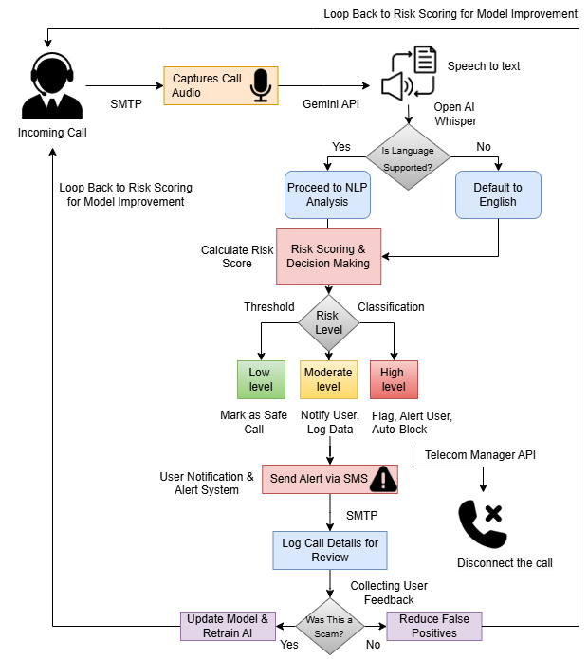


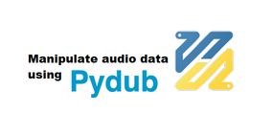





Proposed Architecture
Technology Used :
Programming Language:
Speech-to-Text Conversion:
Natural Language Processing (NLP) :
Backend & Deployment:
Caller ID Verification & Alerts:

Slide 4



Innovation & Uniqueness
1.
2.
3.
AI-Powered: Dynamic scam detection instead of static blacklists.
Voice Biometrics: Detects scam attempts based on voice patterns.
Real-Time Analysis: Immediate fraud alerts before users engage.

Slide 5






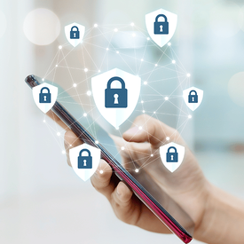

Impact and Benefits
Helps users avoid scam calls
Reduces phone fraud cases
Detects fraud before it happens
Protects individuals & businesses from scams
Filters out malicious callers automatically
Integrate AI-driven call authentication for banks & telecom providers

Slide 6
FEASIBILITY
Technical Feasibility: Uses existing APIs (Google Speech, Twilio, NLP models) for scalability.
Operational Feasibility: Works on any smartphone via app integration.
Minimal user input required – fully automated fraud detection.

Slide 7

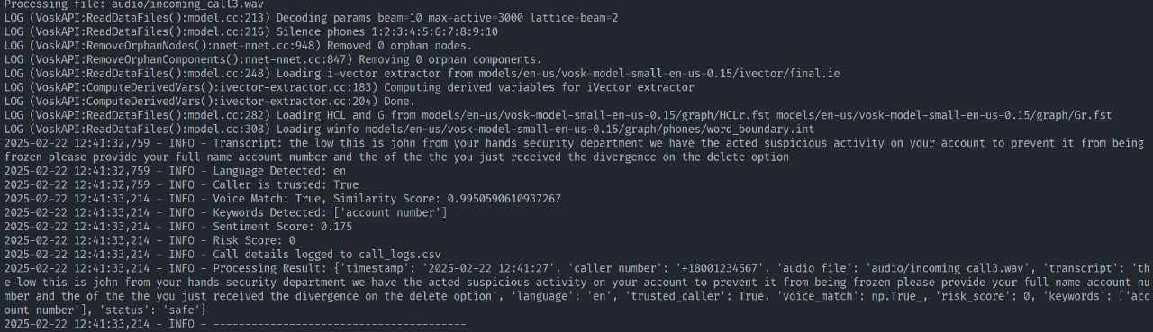
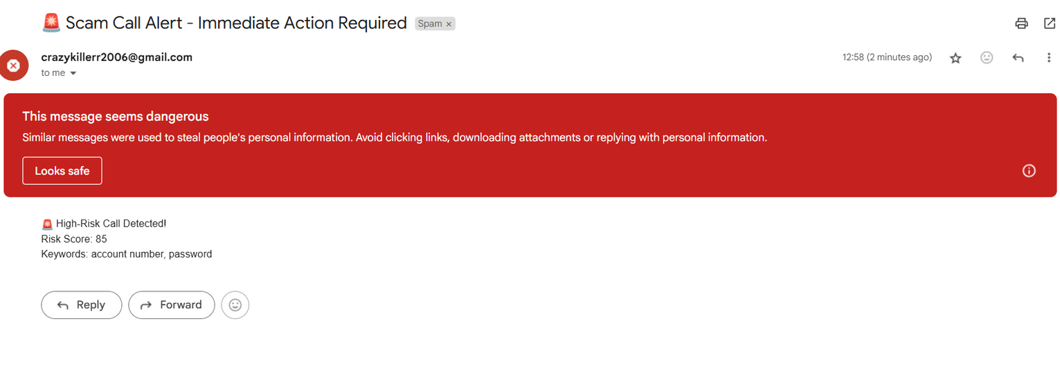
Output

Slide 8

Reference and conclusion
1. Vosk Speech-to-Text Model (Offline ASR Engine) – https://alphacephei.com/vosk
2. pydub (Audio Processing Library) – https://github.com/jiaaro/pydub
Conclusion:
The Spam Call Detection App effectively identifies spam calls in real-time and alerts users instantly. By integrating ML-based detection or Caller ID APIs, it enhances call security while providing a seamless user experience. With a simple yet powerful UI, users can enable or disable spam detection effortlessly. This project showcases expertise in Android development, real-time call analysis, and system-level integrations, making it a valuable tool for protecting users from unwanted call
3. langdetect (Language Detection Library) – https://pypi.org/project/langdetect/
4. FastAPI (Backend Development) – https://fastapi.tiangolo.com/
5. Federal Trade Commission (FTC) – Phone Scam Awareness – https://consumer.ftc.gov/scams

